Slide 1

Data Communication and Computer Networks
4. Transport Layer
PART-A
Dr. Aiman Hanna
Department of Computer Science & Software Engineering Concordia University, Montreal, Canada
These slides has mainly been extracted, modified and updated from original slides of : Computer Networking: A Top Down Approach, 6th edition Jim Kurose, Keith Ross Addison-Wesley, 2013
Additional materials have been extracted, modified and updated from: Understanding Communications and Networking, 3e by William A. Shay 2005
Copyright © 1996-2013 J.F Kurose and K.W. Ross
Copyright © 2005 William A. Shay
Copyright © 2018 Aiman Hanna All rights reserved

Slide 2

















Transport services and protocols
application
transport
network
data link
physical
provide logical communication between app processes running on different hosts
transport protocols run in end systems
send side: breaks app messages into segments, passes to network layer
rcv side: reassembles segments into messages, passes to app layer
more than one transport protocol available to apps
Internet: TCP and UDP
logical end-end transport
application
transport
network
data link
physical
Transport Layer A
3-‹#›

Slide 3
Transport vs. network layer
household analogy:
network layer: logical communication between hosts
transport layer: logical communication between processes
relies on, enhances, network layer services
12 kids in Ann’s house sending letters to 12 kids in Bill’s house:
hosts = houses
processes = kids
app messages = letters in envelopes
transport protocol = Ann and Bill who demux to in-house siblings (responsible for collection and distribution)
network-layer protocol = postal service (move letters from house to house, not from person to person)
Transport Layer A
3-‹#›

Slide 4
Internet transport-layer protocols
reliable, in-order delivery (TCP)
congestion control
flow control
connection setup
unreliable, unordered delivery: UDP
no-frills extension of
“best-effort” IP
services not available:
delay guarantees (timing)
bandwidth guarantees (throughput)
➔ Why there are no such guarantees?
application
transport
network
data link
physical
network
data link
physical
network
data link
physical
network
data link
physical
logical end-end transport
network
data link
physical
network
data link
physical
network
data link
physical
network
data link
physical
application
transport
network
data link
physical
Transport Layer A
3-‹#›

Slide 5
UDP: User Datagram Protocol [RFC 768]
“no frills,” “bare bones” Internet transport protocol
“best effort” service, UDP segments may be:
delivered out-of-order to app
lost
connectionless:
no handshaking between UDP sender, receiver
each UDP segment handled independently of others
UDP is used by:
streaming multimedia apps (loss tolerant, rate sensitive)
DNS
SNMP
RIP
reliable transfer over UDP:
add reliability at application layer
application-specific error recovery!
Transport Layer A
3-‹#›

Slide 6
UDP
why is there a UDP?
finer application-level control over what is sent and when
no connection establishment (which can add delay)
no congestion control: UDP can blast away as fast as desired
no need for retransmission to achieve reliability (not needed in many cases)
simple: no connection state at sender, receiver
small header size: 8 bytes of header overhead compared to 20 bytes with TCP
Transport Layer A
3-‹#›

Slide 7
UDP: segment header
length, in bytes of UDP segment, including header
32 bits
source port #
dest port #
length
checksum
data field may contain for instance a DNS request or query, or streaming data
length indicates the amount of attached data since it varies
Checksum is used to perform basic error detection
application
data
(payload)
UDP segment format
Transport Layer A
3-‹#›

Slide 8
UDP checksum
Goal: detect “errors” (e.g., flipped bits) in transmitted segment
sender:
treat segment contents, including header fields, as sequence of 16-bit integers
checksum: addition (one’s complement sum) of segment contents
sender puts checksum value into UDP checksum field
receiver:
compute checksum of received segment
check if computed checksum equals checksum field value:
NO - error detected
YES - no error detected. But maybe errors nonetheless? More later ….
Transport Layer A
3-‹#›

Slide 9
Internet checksum: example
example: add two 16-bit integers
0 0 1 0 0 1 1 0 0 1 1 0 0 1 1 0
0 1 0 1 0 1 0 1 0 1 0 1 0 1 0 1
0 1 1 1 1 0 1 1 1 0 1 1 1 0 1 1
1 0 0 0 0 1 0 0 0 1 0 0 0 1 0 0
sum
checksum
Transport Layer A
3-‹#›

Slide 10
Internet checksum: example
at the receiver, add both numbers to the checksum.
result should be all 1s; otherwise something has been altered
1st number
0 0 1 0 0 1 1 0 0 1 1 0 0 1 1 0
0 1 0 1 0 1 0 1 0 1 0 1 0 1 0 1
1 0 0 0 0 1 0 0 0 1 0 0 0 1 0 0
2nd number
checksum
result
1 1 1 1 1 1 1 1 1 1 1 1 1 1 1 1
Transport Layer A
3-‹#›

Slide 11
UDP checksum
why UDP provides error-detection in the first place?
error-checking is done at the data-link layer, however:
at one, or more, of the links in between, the utilized protocol may not provide error checking, which in essence nullifies all the rest of the checking
even if all links provide error checking, the packets may get altered while being stored in routers memory
UDP provides error checking as an end-end principle
Since the data finally made it to the destination, at least warn the user in case it is altered
user may accept it with a warning, or reject it
Notice that after all UDP does not do anything in case an error has occurred
Transport Layer A
3-‹#›

Slide 12
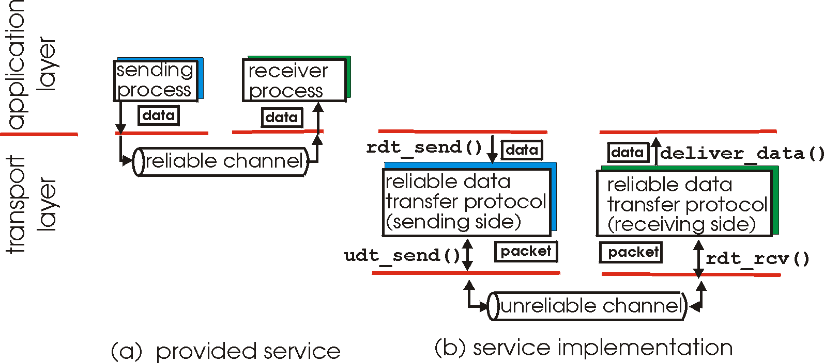
Principles of reliable data transfer
important in Application, Transport, and Data-Link layers
top-10 list of important networking topics!
characteristics of unreliable channel will determine complexity of reliable data transfer protocol (rdt)
Transport Layer A
3-‹#›

Slide 13
Principles of reliable data transfer
important in application, transport, link layers
top-10 list of important networking topics!
characteristics of unreliable channel will determine complexity of reliable data transfer protocol (rdt)
Transport Layer A
3-‹#›

Slide 14
Principles of reliable data transfer
important in application, transport, link layers
top-10 list of important networking topics!
characteristics of unreliable channel will determine complexity of reliable data transfer protocol (rdt)
Transport Layer A
3-‹#›

Slide 15
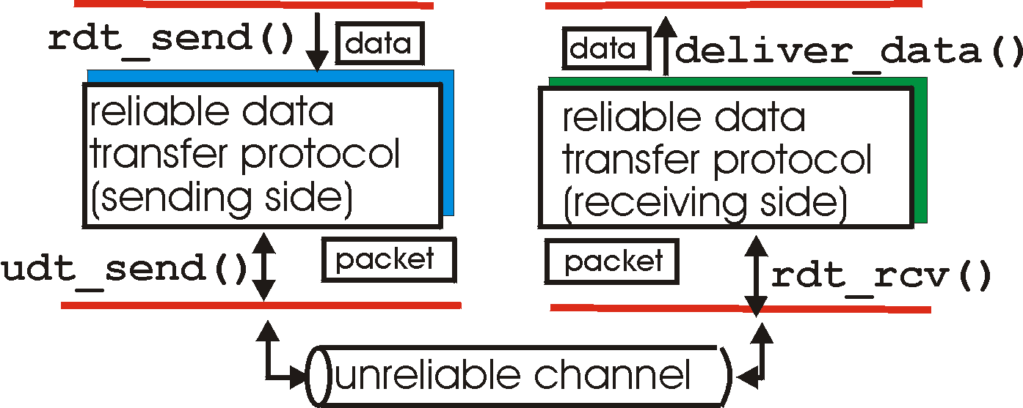
Reliable data transfer: getting started
rdt_send(): called from above, (e.g., by app.). Passed data is to be
delivered to receiver upper layer
deliver_data(): called by rdt to deliver data to upper layer
send
side
receive
side
udt_send(): called by rdt,
to transfer packet over
unreliable channel to receiver
rdt_rcv(): called when packet arrives on rcv-side of channel
Transport Layer A
3-‹#›

Slide 16
Reliable data transfer: getting started
we’ll:
incrementally develop sender, receiver sides of reliable data transfer protocol (rdt)
consider only unidirectional data transfer
but control info will flow on both directions!
use finite state machines (FSM) to specify sender, receiver
event causing state transition
actions taken on state transition
state: when in this “state” next state uniquely determined by next event
State 1
State 2
event
actions
Transport Layer A
3-‹#›

Slide 17
rdt1.0: reliable transfer over a reliable channel
underlying channel perfectly reliable
no bit errors
no loss of packets
no need for receiver to send feedback to the sender
separate FSMs for sender, receiver:
sender sends data into underlying channel
receiver reads data from underlying channel
such protocols are referred to as Unrestricted Protocols
Wait for call from above
rdt_send(data)
Wait for call from below
rdt_rcv(packet)
packet = make_pkt(data)
udt_send(packet)
extract (packet,data)
deliver_data(data)
rdt 1.0 sending side
rdt 1.0 receiving side
Transport Layer A
3-‹#›

Slide 18
rdt2.0: channel with bit errors
underlying channel may flip bits in packet
checksum to detect bit errors
however, for now we assume no loss
the question: how to recover from errors:
acknowledgements (ACKs): receiver explicitly tells sender that pkt received OK
negative acknowledgements (NAKs): receiver explicitly tells sender that pkt had errors
sender retransmits pkt on receipt of NAK
new mechanisms in rdt2.0 (beyond rdt1.0):
error detection
receiver feedback: control msgs (ACK,NAK) rcvr->sender
How do humans recover from “errors”
during conversation?
Transport Layer A
3-‹#›

Slide 19
rdt2.0: channel with bit errors
underlying channel may flip bits in packet
checksum to detect bit errors
the question: how to recover from errors:
acknowledgements (ACKs): receiver explicitly tells sender that pkt received OK
negative acknowledgements (NAKs): receiver explicitly tells sender that pkt had errors
sender retransmits pkt on receipt of NAK
new mechanisms in rdt2.0 (beyond rdt1.0):
error detection
feedback: control msgs (ACK,NAK) from receiver to sender
Retransmission
protocols based on ACKs and NAKs retransmission are referred to as ARQ (Automatic Repeat reQuest) protocols
Transport Layer A
3-‹#›

Slide 20
rdt2.0: FSM specification
rdt_rcv(rcvpkt) && corrupt(rcvpkt)
rdt_send(data)
sndpkt = make_pkt(NAK)
sndpkt = make_pkt(data, checksum)
udt_send(sndpkt)
udt_send(sndpkt )
rdt_rcv(rcvpkt) &&
isNAK(rcvpkt)
Wait for call from below
Wait for call from above
Wait for ACK or NAK
udt_send(sndpkt)
rdt_rcv(rcvpkt) && notcorrupt(rcvpkt)
rdt_rcv(rcvpkt) && isACK(rcvpkt)
extract(rcvpkt, data)
deliver_data(data)
sndpkt = make_pkt(ACK)
udt_send(sndpkt )
Λ
rdt 2.0 sending side
rdt 2.0 receiving side
Λ ≡ no action required
Transport Layer A
3-‹#›

Slide 21
rdt2.0: operation with no errors
rdt_send(data)
sndpkt = make_pkt(data, checksum)
udt_send(sndpkt)
rdt_rcv(rcvpkt) &&
isNAK(rcvpkt)
rdt_rcv(rcvpkt) && corrupt(rcvpkt)
Wait for call from above
Wait for ACK or NAK
udt_send(sndpkt)
sndpkt = make_pkt(NAK)
udt_send(sndpkt )
Wait for call from below
rdt_rcv(rcvpkt) && isACK(rcvpkt)
Λ
rdt_rcv(rcvpkt) && notcorrupt(rcvpkt)
extract(rcvpkt, data)
deliver_data(data)
sndpkt = make_pkt(ACK)
udt_send(sndpkt )
Transport Layer A
3-‹#›

Slide 22
rdt2.0: error scenario
rdt_send(data)
sndpkt = make_pkt(data, checksum)
udt_send(sndpkt)
rdt_rcv(rcvpkt) &&
isNAK(rcvpkt)
rdt_rcv(rcvpkt) && corrupt(rcvpkt)
Wait for call from above
Wait for ACK or NAK
udt_send(sndpkt)
sndpkt = make_pkt(NAK)
udt_send(sndpkt )
Wait for call from below
rdt_rcv(rcvpkt) && isACK(rcvpkt)
Λ
rdt_rcv(rcvpkt) && notcorrupt(rcvpkt)
extract(rcvpkt, data)
deliver_data(data)
sndpkt = make_pkt(ACK)
udt_send(sndpkt )
Note: This shows an error scenario followed by a no-error one
Transport Layer A
3-‹#›

Slide 23
rdt2.0 has a fatal flaw!
remember, we still assume no loss is possible, however:
what happens if ACK/NAK corrupted?
sender doesn’t know what happened at receiver!
can’t just retransmit to solve the problem!
possible duplicates
handling duplicates:
sender retransmits current pkt if ACK/NAK corrupted
sender adds sequence number to each pkt
receiver discards (doesn’t deliver up) duplicate pkt
stop and wait
sender sends one packet,
then waits for receiver
response
Transport Layer A
3-‹#›

Slide 24
rdt2.1: sender, handles garbled ACK/NAKs
rdt_send(data)
sndpkt = make_pkt(0, data, checksum)
udt_send(sndpkt)
rdt_rcv(rcvpkt) &&
( corrupt(rcvpkt) || isNAK(rcvpkt))
Wait for call 0 from above
Wait for ACK or NAK
udt_send(sndpkt)
rdt_rcv(rcvpkt)
&& notcorrupt(rcvpkt)
&& isACK(rcvpkt)
rdt_rcv(rcvpkt)
&& notcorrupt(rcvpkt) && isACK(rcvpkt)
Λ
Wait for ACK or NAK
Wait for
call 1 from above
Λ
rdt_rcv(rcvpkt) &&
(corrupt(rcvpkt) ||
isNAK(rcvpkt))
rdt_send(data)
udt_send(sndpkt)
sndpkt = make_pkt(1, data, checksum)
udt_send(sndpkt)
rdt 2.1 sending side
Transport Layer A
3-‹#›

Slide 25
rdt2.1: receiver, handles garbled ACK/NAKs
rdt_rcv(rcvpkt) && notcorrupt(rcvpkt)
&& has_seq0(rcvpkt)
extract(rcvpkt,data)
deliver_data(data)
sndpkt = make_pkt(ACK, chksum)
udt_send(sndpkt)
rdt_rcv(rcvpkt) && corrupt(rcvpkt)
rdt_rcv(rcvpkt) && corrupt(rcvpkt)
sndpkt = make_pkt(NAK, chksum)
udt_send(sndpkt)
sndpkt = make_pkt(NAK, chksum)
udt_send(sndpkt)
Wait for
0 from below
Wait for
1 from below
rdt_rcv(rcvpkt) &&
not corrupt(rcvpkt) &&
has_seq1(rcvpkt)
rdt_rcv(rcvpkt) &&
not corrupt(rcvpkt) &&
has_seq0(rcvpkt)
sndpkt = make_pkt(ACK, chksum)
udt_send(sndpkt)
sndpkt = make_pkt(ACK, chksum)
udt_send(sndpkt)
rdt_rcv(rcvpkt) && notcorrupt(rcvpkt) && has_seq1(rcvpkt)
extract(rcvpkt,data)
deliver_data(data)
sndpkt = make_pkt(ACK, chksum)
udt_send(sndpkt)
rdt 2.1 receiving side
Transport Layer A
3-‹#›

Slide 26
rdt2.1: discussion
sender:
seq # added to pkt
two seq. #’s (0,1) will suffice. Why?
must check if received ACK/NAK corrupted
twice as many states
state must “remember” whether “expected” pkt should have seq # of 0 or 1
receiver:
must check if received packet is duplicate
state indicates whether 0 or 1 is expected pkt seq #
note: receiver can not know if its last ACK/NAK received OK at sender
Transport Layer A
3-‹#›

Slide 27
rdt2.2: a NAK-free protocol
same functionality as rdt2.1, using ACKs only
instead of NAK, receiver sends ACK for last pkt received OK
receiver must explicitly include seq # of pkt being ACKed
duplicate ACK at sender results in same action as NAK: retransmit current pkt
Transport Layer A
3-‹#›

Slide 28
rdt2.2: sender
rdt_send(data)
sndpkt = make_pkt(0, data, checksum)
udt_send(sndpkt)
rdt_rcv(rcvpkt) &&
(corrupt(rcvpkt) || isACK(rcvpkt.1))
Wait for call 0 from above
Wait for ACK0
udt_send(sndpkt)
rdt_rcv(rcvpkt)
&& notcorrupt(rcvpkt)
&& isACK(rcvpkt,1)
rdt_rcv(rcvpkt)
&& notcorrupt(rcvpkt) && isACK(rcvpkt, 0)
Λ
Wait for ACK1
Wait for
call 1 from above
Λ
rdt_rcv(rcvpkt) &&
(corrupt(rcvpkt) ||
isACK(rcvpkt, 0))
rdt_send(data)
udt_send(sndpkt)
sndpkt = make_pkt(1, data, checksum)
udt_send(sndpkt)
rdt 2.2 sending side
Transport Layer A
3-‹#›

Slide 29
rdt2.2: receiver
rdt_rcv(rcvpkt) && notcorrupt(rcvpkt)
&& has_seq0(rcvpkt)
extract(rcvpkt,data)
deliver_data(data)
sndpkt = make_pkt(ACK, 0, chksum)
udt_send(sndpkt)
rdt_rcv(rcvpkt) && (corrupt(rcvpkt) || has_seq0(revpkt))
Wait for
0 from below
Wait for
1 from below
rdt_rcv(rcvpkt) && (corrupt(rcvpkt) || has_seq1(rcvpkt))
sndpkt = make_pkt(ACK, 0, chksum)
udt_send(sndpkt)
sndpkt = make_pkt(ACK, 1, chksum)
udt_send(sndpkt)
rdt_rcv(rcvpkt) && notcorrupt(rcvpkt) && has_seq1(rcvpkt)
extract(rcvpkt,data)
deliver_data(data)
sndpkt = make_pkt(ACK, 1, chksum)
udt_send(sndpkt)
rdt 2.2 receiving side
Transport Layer A
3-‹#›

Slide 30
rdt3.0: channels with errors and loss
Previous versions assumed no-loss channels
Packets may have errors, but they will always arrive
new realistic assumption: underlying channel can also lose packets (data, ACKs)
checksum, seq. #, ACKs, retransmissions will be of help … but not enough
approach: sender waits “reasonable” amount of time for ACK
retransmits if no ACK received in this time
if pkt (or ACK) just delayed (not lost):
retransmission will be duplicate, but seq. #’s already handles this
receiver must specify seq # of pkt being ACKed
requires countdown timer
Transport Layer A
3-‹#›

Slide 31
rdt3.0 sender
rdt_send(data)
rdt_rcv(rcvpkt) &&
( corrupt(rcvpkt) ||
isACK(rcvpkt,1) )
sndpkt = make_pkt(0, data, checksum)
udt_send(sndpkt)
start_timer
rdt_rcv(rcvpkt)
Λ
Λ
Wait for
call 0 from above
Wait for ACK0
timeout
udt_send(sndpkt)
start_timer
rdt_rcv(rcvpkt)
&& notcorrupt(rcvpkt)
&& isACK(rcvpkt,1)
rdt_rcv(rcvpkt)
&& notcorrupt(rcvpkt)
&& isACK(rcvpkt,0)
stop_timer
stop_timer
Wait for ACK1
Wait for
call 1 from above
timeout
udt_send(sndpkt)
start_timer
rdt_rcv(rcvpkt)
rdt_send(data)
Λ
rdt_rcv(rcvpkt) &&
( corrupt(rcvpkt) ||
isACK(rcvpkt,0) )
sndpkt = make_pkt(1, data, checksum)
udt_send(sndpkt)
start_timer
Λ
Transport Layer A
3-‹#›

Slide 32
rdt3.0: receiver
rdt_rcv(rcvpkt) && notcorrupt(rcvpkt)
&& has_seq0(rcvpkt)
extract(rcvpkt,data)
deliver_data(data)
sndpkt = make_pkt(ACK, 0, chksum)
udt_send(sndpkt)
rdt_rcv(rcvpkt) && (corrupt(rcvpkt) || has_seq0(revpkt))
Wait for
0 from below
Wait for
1 from below
rdt_rcv(rcvpkt) && (corrupt(rcvpkt) || has_seq1(rcvpkt))
sndpkt = make_pkt(ACK, 0, chksum)
udt_send(sndpkt)
sndpkt = make_pkt(ACK, 1, chksum)
udt_send(sndpkt)
rdt_rcv(rcvpkt) && notcorrupt(rcvpkt) && has_seq1(rcvpkt)
extract(rcvpkt,data)
deliver_data(data)
sndpkt = make_pkt(ACK, 1, chksum)
udt_send(sndpkt)
rdt 3.0 receiving side
Transport Layer A
3-‹#›

Slide 33

rdt3.0 in action
sender
receiver
sender
receiver
send pkt0
pkt0
send pkt0
pkt0
rcv pkt0
rcv pkt0
ack0
send ack0
ack0
send ack0
rcv ack0
rcv ack0
send pkt1
pkt1
send pkt1
pkt1
rcv pkt1
X
ack1
send ack1
loss
rcv ack1
send pkt0
pkt0
rcv pkt0
timeout
resend pkt1
ack0
send ack0
pkt1
rcv pkt1
ack1
send ack1
rcv ack1
send pkt0
pkt0
(a) no loss
rcv pkt0
ack0
send ack0
(b) packet loss
Transport Layer A
3-‹#›

Slide 34
rdt3.0 in action
sender
receiver
sender
receiver
send pkt0
pkt0
send pkt0
pkt0
rcv pkt0
rcv pkt0
ack0
send ack0
send ack0
rcv ack0
ack0
send pkt1
pkt1
rcv ack0
rcv pkt1
send pkt1
pkt1
send ack1
rcv pkt1
ack1
send ack1
ack1
X
loss
timeout
resend pkt1
pkt1
rcv pkt1
timeout
resend pkt1
rcv ack1
pkt1
rcv pkt1
pkt0
(detect duplicate)
send pkt0
send ack1
ack1
(detect duplicate)
ack1
rcv pkt0
rcv ack1
send ack1
rcv ack1
ack0
send ack0
pkt0
resend pkt0
pkt0
send pkt0
rcv pkt0
rcv pkt0
ack0
(detect duplicate)
ack0
send ack0
send ack0
(c) ACK loss
(d) premature timeout/ delayed ACK
Transport Layer A
3-‹#›

Slide 35
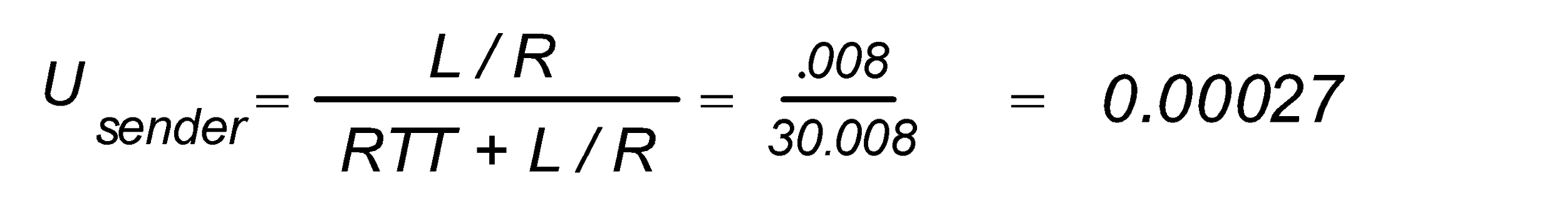
Performance of rdt3.0
since sequence # alternates between 1 & 0, such protocols are known as Alternating-bit protocols
rdt3.0 is correct, but performance stinks
e.g.: 1 Gbps link, 15 ms prop. delay, 8000 bit packet:
L
8000 bits
D_{trans} =
=
=
8 microsecs
R
10 ⁹ bits/sec
U _{sender}: utilization – fraction of time sender busy sending
if RTT=30 msec, 8000 bit pkt every 0.030008 sec,
➔ throughput over 1 Gbps link is only: 266.6 kbps
network protocol limits use of physical resources!
Transport Layer A
3-‹#›

Slide 36
rdt3.0: stop-and-wait operation
sender
receiver
first bit of first packet transmitted, t = 0
last packet bit transmitted, t = L / R
first packet bit arrives
RTT
last packet bit arrives, send ACK
ACK arrives, send next packet, t = RTT + L / R
Transport Layer A
3-‹#›

Slide 37
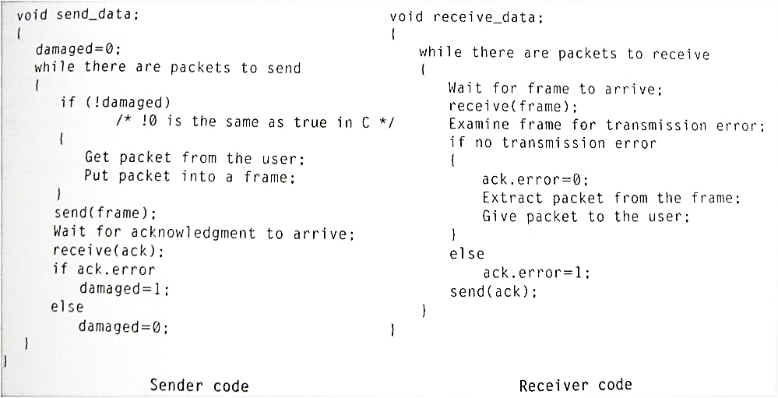
Stop-and-Wait Protocols
Note: This is stop-and-wait in general; it is not related to rtd3.0
Sender sends one frame, then waits for an acknowledgment (ACK) from the receiver
If the frame is damaged, this will also be indicated in the ACK
Stop-and-Wait Flow Control
3-‹#›
Transport Layer A

Slide 38
Stop-and-Wait
Analysis of stop-and-wait
Notice that this is a general analysis of stop-and wait, and has nothing to do with rdt3.0 in particular.
What if frame is lost?
What if ACK is lost?
What if ACK is received but it is damaged?
What about efficiency;
Is the protocol too slow and is there a lot of waiting at both sides?
What is good about that protocol?
Transport Layer A
3-‹#›

Slide 39
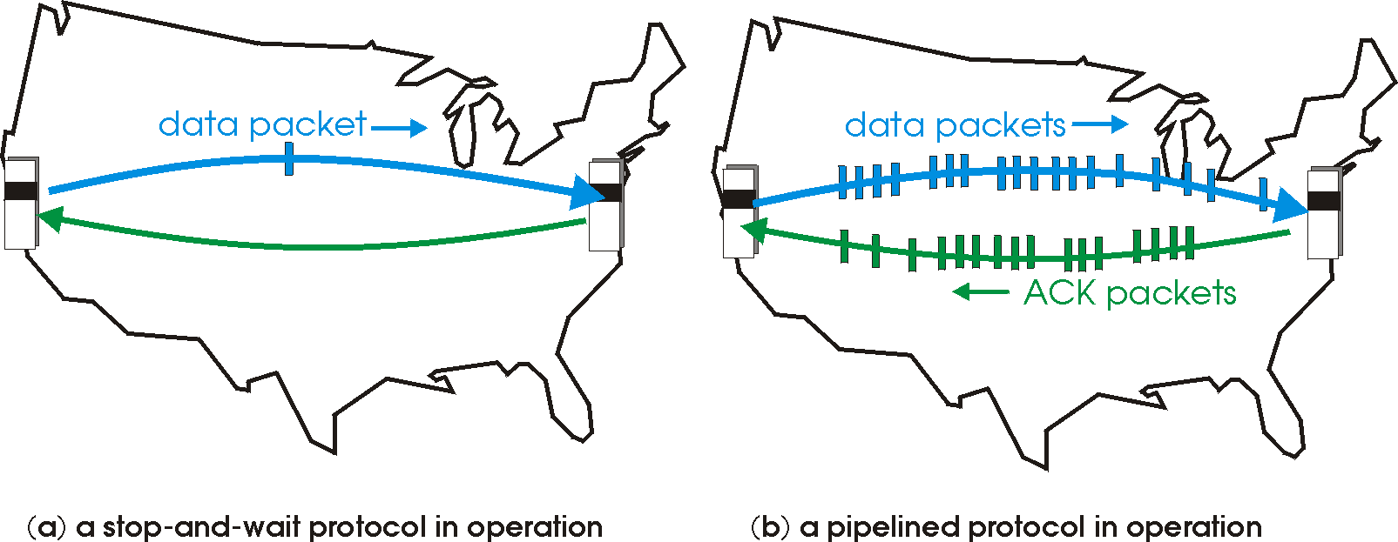

Pipelined protocols
pipelining: sender allows multiple, “in-flight”, yet-to-be-acknowledged pkts
range of sequence numbers must be increased
buffering at sender and/or receiver
two generic forms of pipelined protocols:
Go-Back-N,
Selective Repeat
Transport Layer A
3-‹#›

Slide 40
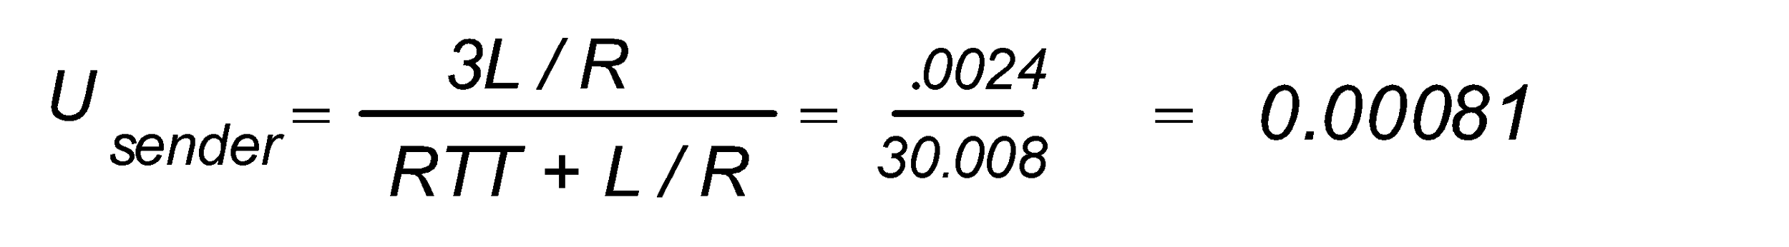
Pipelining: increased utilization
sender
receiver
first packet bit transmitted, t = 0
last bit transmitted, t = L / R
first packet bit arrives
RTT
last packet bit arrives, send ACK
last bit of 2nd packet arrives, send ACK
last bit of 3rd packet arrives, send ACK
ACK arrives, send next
packet, t = RTT + L / R
3-packet pipelining increases
utilization by a factor of 3!
Transport Layer A
3-‹#›

Slide 41
Another look at Protocol Efficiency
Protocol Efficiency
There are different ways to measure efficiency
One measure to efficiency is the Effective Data Rate
Effective data rate is number of transferred bits per unit of time
It can be calculated as:
Number of sent data bits / Elapsed time between sending of two consecutive frames
Transport Layer A
3-‹#›

Slide 42
Another look at Protocol Efficiency
Protocol Efficiency
Assume:
R: bit rate (bps)
S: signal speed (meters/µsec)
D: distance between sender and receiver (meters)
T: time to create a frame
F: frame bits (# of bits per frame including header)
N: data bits (# of data bits per frame)
A: number of bits in an ACK frame
Transport Layer A
3-‹#›

Slide 43
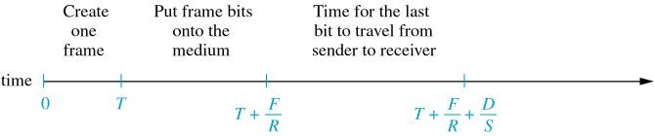
Another look at Protocol Efficiency
Time Required to Send a Frame to Receiver
Transport Layer A
3-‹#›

Slide 44
Another look at Protocol Efficiency
Protocol Efficiency
For the unrestricted protocol, elapsed time between sending consecutive frames is:
time = T + F/R
➔ EDR = N/(T + F/R)
For the stop-and-wait protocol, it is:
time to send a frame + time to get ACK back
time = (T + F/R + D/S) + (T + A/R + D/S)
Note: the time needed to create an ACK frame may actually differ from the time needed to create a full frame. We assume that the two are the same just for simplicity
➔ EDR = N/[2(T + D/S) + (F + A)/R]
Transport Layer A
3-‹#›

Slide 45
Another look at Protocol Efficiency
Protocol Efficiency
Example: Assume:
R = 10 Mbps (10 bits /µsec)
S = 200 meters/µsec
D = 200 meters
T = 1 µsec
F = 200 bits
N = 160 bits
A = 40 bits
for the unrestricted protocol:
➔ EDR = N/(T + F/R) ≈ 7.6 Mbps
for the stop-and-wait protocol,
➔ EDR = N/[2(T + D/S) + (F + A)/R] ≈ 5.7 Mbps
Transport Layer A
3-‹#›

Slide 46
Protocol Efficiency
the unrestricted protocol and the stop-and-wait protocol are two extremes
in practice, we may need some other protocol that falls in between these extremes
Sliding Window protocols provide such alternative
two major implementation of sliding window protocols are:
Go-back-n
Selective Repeat
Transport Layer A
3-‹#›

Slide 47
Pipelined protocols: overview
Also referred to as Sliding Windows protocols
Go-back-N:
sender can have up to N unacked packets in pipeline
receiver only sends cumulative ack
doesn’t ack packet if there’s a gap
sender has timer for oldest unacked packet
when timer expires, retransmit all unacked packets
Selective Repeat:
sender can have up to N unack’ed packets in pipeline
rcvr sends individual ack for each packet
sender maintains timer for each unacked packet
when timer expires, retransmit only that unacked packet
Transport Layer A
3-‹#›

Slide 48
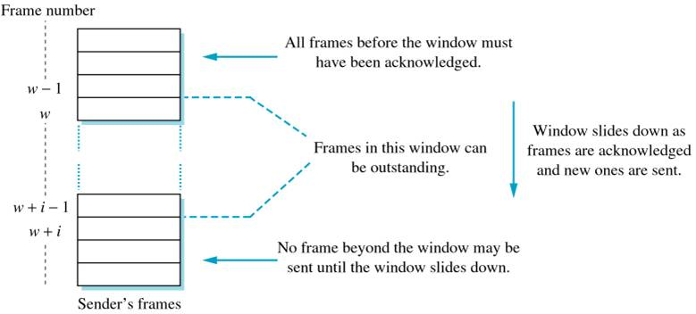
Sliding Window
sliding window protocol numbers the frames to be sent and defines a window of these frames
A Sliding Window Protocol
Transport Layer A
3-‹#›

Slide 49

Go-Back-N Protocol
Go-back-n requires frames to be received in the same order they are sent
the receiver hence rejects all out-of-order frames; in other words, it rejects all frames but the next expected one
in reality, communication can be full-duplex, so data is sent in both directions
instead of sending separate ACK frames, ACKs can be sent along with data
this is called piggybacking
Typical Frame Format
Transport Layer A
3-‹#›

Slide 50
Go-Back-N Protocol
details of Go-back-n:
if the Number field in the frame has k bits, then frames can be numbered from 0 → 2^{k} - 1
if there is more than 2^{k} frames, then frame numbers are duplicated. For example, if k=3, then frames will be 0, 1, …, 6, 7, 0, 1, …
receiver expects frames in order. Any out-of-order frames are rejected and a NAK is sent for the expected frame
if the expected frame is received but damaged, then it is discarded and a NAK is sent
not every frame is explicitly ACKed For example, if sender sends frames 35, 36, 37, 38 & 39, ACKs for 36 & 39 may be sent. ACK for 36 implicitly indicates that 35 & 36 were accepted. ACK for 39 implicitly indicate that 37, 38 & 39 were accepted
Transport Layer A
3-‹#›

Slide 51
Go-Back-N Protocol
details of Go-back-n (continue…):
piggybacking is used whenever possible, however frames must be ACKed within a specific time period
an ACK timer is defined at the receiver; if this timer reaches its limit, the frame must be ACKed even without piggybacking
if the sender does not receive an ACK within a time period (a frame timer is used here), it assumes that something has gone wrong and so it resends every packet in its window
in other words, the sender goes back to the beginning of the window (n) and resends all frames in the window; that is the reason behind the name: go-back-n
Transport Layer A
3-‹#›

Slide 52
GBN in action
sender window (N=4)
sender
receiver
0 1 2 3 4 5 6 7 8
send pkt0
send pkt1
send pkt2
send pkt3
(wait)
0 1 2 3 4 5 6 7 8
receive pkt0, send ack0
receive pkt1, send ack1
receive pkt3, discard,
(re)send ack1
0 1 2 3 4 5 6 7 8
X
0 1 2 3 4 5 6 7 8
loss
0 1 2 3 4 5 6 7 8
rcv ack0, send pkt4
rcv ack1, send pkt5
0 1 2 3 4 5 6 7 8
receive pkt4, discard,
(re)send ack1
ignore duplicate ACK
receive pkt5, discard,
(re)send ack1
pkt 2 timeout
0 1 2 3 4 5 6 7 8
send pkt2
send pkt3
send pkt4
send pkt5
0 1 2 3 4 5 6 7 8
0 1 2 3 4 5 6 7 8
rcv pkt2, deliver, send ack2
rcv pkt3, deliver, send ack3
rcv pkt4, deliver, send ack4
rcv pkt5, deliver, send ack5
0 1 2 3 4 5 6 7 8
Transport Layer A
3-‹#›

Slide 53
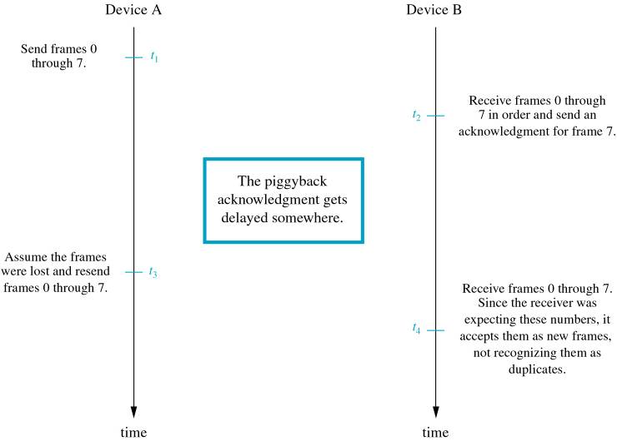
Go-Back-N Protocol
what is the maximum window size?
Protocol Failure when Window Size = 2^{k}
3-‹#›
Transport Layer A

Slide 54
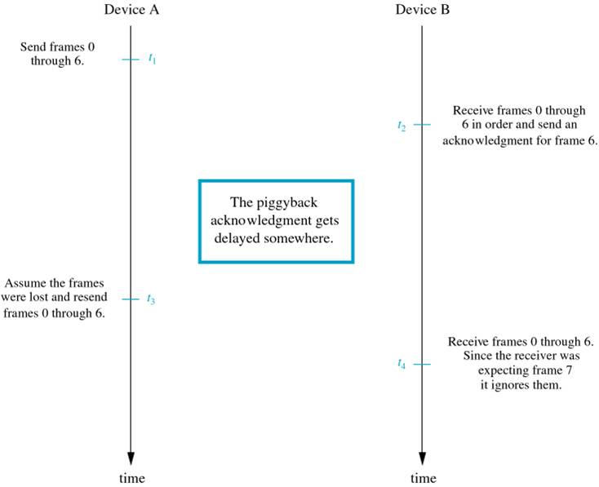
Go-Back-N Protocol
what is the maximum window size?
Protocol Success when Window Size = 2^{k} -1
3-‹#›
Transport Layer A

Slide 55
Selective repeat
Go-back-n works well only under certain conditions (what are these?)
once these conditions change, the protocol becomes less efficient
selective repeat provides an alternative
with selective repeat, the receiver is required to accept (buffers) frames even they are out of order
all frames must however be reordered before being delivered
Transport Layer A
3-‹#›

Slide 56
Selective repeat
Details of Selective Repeat:
Selective repeat is similar to go-back-n in the following:
Uses the same frame format
All frames are numbered using k-bit field
Sender has a window that defines the maximum number of outstanding frames
ACKs are piggybacked whenever possible
Not all frames are explicitly ACKed
Uses NACKs (or duplicate ACKs if protocol is NAK-free) for damaged and out-of-order frames
There is an ACK timer that is used to force the sending of an ACK frame if piggybacked is not possible
The similarities end here!
Transport Layer A
3-‹#›

Slide 57
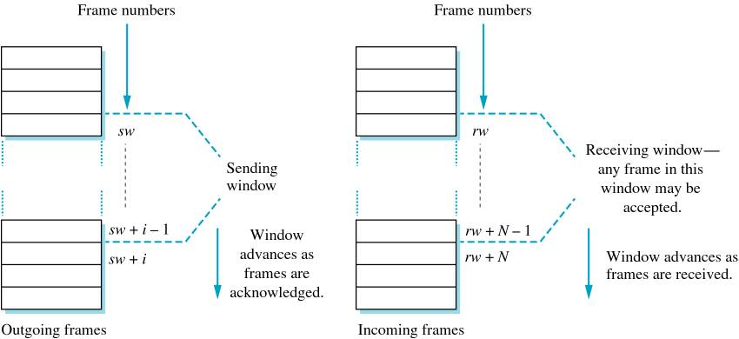
Selective repeat
Details of Selective Repeat (continue…):
Sending & Receiving Windows for Selective Repeat Protocol
Transport Layer A
3-‹#›

Slide 58
Selective repeat
details of Selective Repeat (continue…):
out-of-order frames are buffered until all the ones that precede them arrive
once a receiver detects out-of-order arrival, it sends NAK for the expected frame
if the sender receive NAK, it resends only that frame
once all consecutive frames arrive, they are delivered and the receiving window is advanced
if a frame timer expires, only that frame is resent
piggybacking may not ACK the last received frame; rather it ACKs the highest one delivered to the user
Transport Layer A
3-‹#›

Slide 59
Selective repeat in action
Notice that this is a different variation of Selective Repeat , where each packet is explicitly ACKed?
sender window (N=4)
sender
receiver
0 1 2 3 4 5 6 7 8
send pkt0
send pkt1
send pkt2
send pkt3
(wait)
0 1 2 3 4 5 6 7 8
receive pkt0, send ack0
receive pkt1, send ack1
receive pkt3, buffer,
send ack3
0 1 2 3 4 5 6 7 8
X
0 1 2 3 4 5 6 7 8
loss
0 1 2 3 4 5 6 7 8
rcv ack0, send pkt4
rcv ack1, send pkt5
0 1 2 3 4 5 6 7 8
receive pkt4, buffer,
send ack4
record ack3 arrived
receive pkt5, buffer,
send ack5
pkt 2 timeout
0 1 2 3 4 5 6 7 8
send pkt2
0 1 2 3 4 5 6 7 8
record ack4 arrived
0 1 2 3 4 5 6 7 8
rcv pkt2; deliver pkt2,
pkt3, pkt4, pkt5; send ack2
record ack4 arrived
0 1 2 3 4 5 6 7 8
Q: what happens when ack2 arrives?
Transport Layer A
3-‹#›

Slide 60
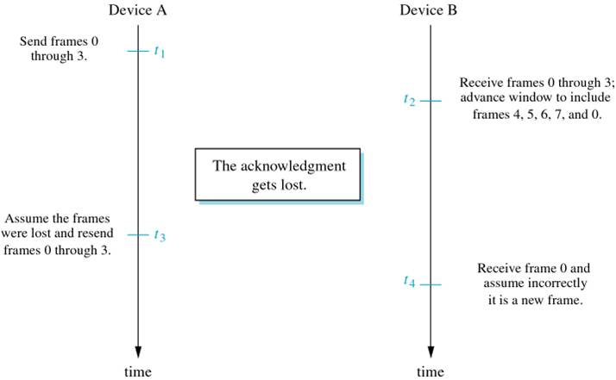
Selective repeat
what is the maximum window size?
➔ constraint: window size must be <= ½ of 2^{k}; which is <= 2^{k-1}
Protocol Failure: Receiving Window size is > 2^{K-1}
Transport Layer A
3-‹#›

Slide 61
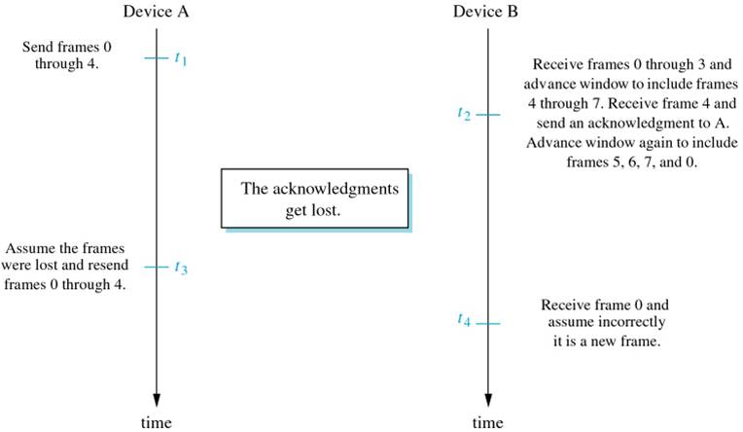
Selective repeat
what is the maximum window size?
➔ constraint: window size must be <= ½ of 2^{k}; which is <= 2^{k-1}
Protocol Failure: Sending Window size is > 2^{K-1}
Transport Layer A
3-‹#›

Slide 62

Selective repeat: dilemma
sender window
(after receipt)
receiver window
(after receipt)
0 1 2 3 0 1 2
pkt0
0 1 2 3 0 1 2
pkt1
0 1 2 3 0 1 2
example:
seq #’s: 0, 1, 2, 3
window size=3
0 1 2 3 0 1 2
pkt2
0 1 2 3 0 1 2
0 1 2 3 0 1 2
0 1 2 3 0 1 2
pkt3
X
0 1 2 3 0 1 2
pkt0
will accept packet
with seq number 0
receiver sees no difference in two scenarios!
duplicate data accepted as new in (b)
Q: what relationship between seq # size and window size to avoid problem in (b)?
(a) no problem
receiver can’t see sender side.
receiver behavior identical in both cases!
something’s (very) wrong!
0 1 2 3 0 1 2
pkt0
0 1 2 3 0 1 2
pkt1
0 1 2 3 0 1 2
0 1 2 3 0 1 2
pkt2
0 1 2 3 0 1 2
X
0 1 2 3 0 1 2
X
timeout
retransmit pkt0
X
0 1 2 3 0 1 2
pkt0
will accept packet
with seq number 0
(b) oops!
Transport Layer A
3-‹#›

Slide 63
Efficiency of Sliding Window Protocols
unrestricted and stop-and-wait efficiency were affected by many factors such as distance, raw bit rate, …etc.
here also, there are many factors that can affect the efficiency of a sliding window protocol; for example, the timer value to trigger resent, the number of frames carrying piggybacking ACKs, …etc.
for simplicity, assume that there are no errors, and that there is enough data sent back so piggybacking is always used
Transport Layer A
3-‹#›

Slide 64
Efficiency of Sliding Window Protocols
Assume:
R: bit rate (bps)
S: signal speed (meters/µsec)
D: distance between sender and receiver (meters)
T: time to create a frame
F: frame bits (# of bits per frame including header)
N: data bits (# of data bits per frame)
A: number of bits in an ACK frame
W: window size
Transport Layer A
3-‹#›

Slide 65
Efficiency of Sliding Window Protocols
now, there are two possibilities:
Case 1) sender window never reaches its maximum size
this is the case when ACKs come back fast enough so the sender just advances its window and sends again
this case then resembles the unrestricted protocol
Case 2) the sender sends all frames in its window before getting any ACK back
this is the case when the sender W frames at a time and then waits for an ACK
this then resembles stop-and-wait, but with window size W instead of 1
the two cases can then be compared by looking at the time needed to send W frames
Transport Layer A
3-‹#›

Slide 66
Efficiency of Sliding Window Protocols
to construct and send 1 frame, we need T + F/R
➔ to construct and send W frames, we need W( T + F/R)
to construct and send ACK back, we need T + A/R
since ACKs are piggybacked, we need T + F/R
we also need D/S for traveling time between sender and receiver
➔ total time to send 1 frame and get ACK back is: 2 (T + F/R +D/S)
for Case 1 (resembling unrestricted protocol):
W( T + F/R) > 2 (T + F/R +D/S)
for Case 2 (resembling W-Oriented stop-and-wait):
W( T + F/R) < 2 (T + F/R +D/S)
Transport Layer A
3-‹#›

Slide 67
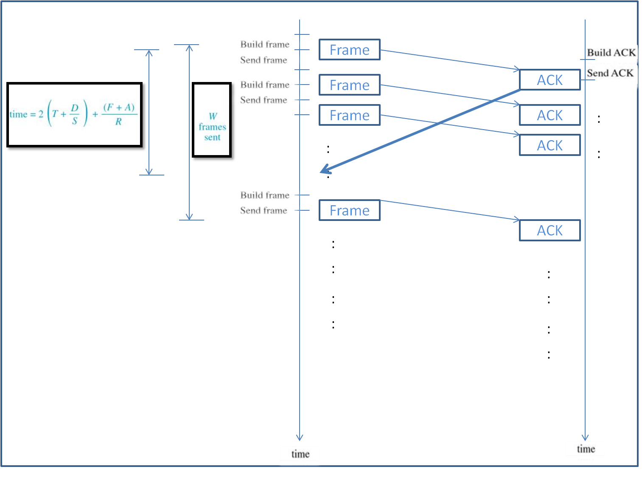
Efficiency of Sliding Window Protocols
ACKs Received before Sending All Windowed Frames – Case 1
Transport Layer A
3-‹#›

Slide 68
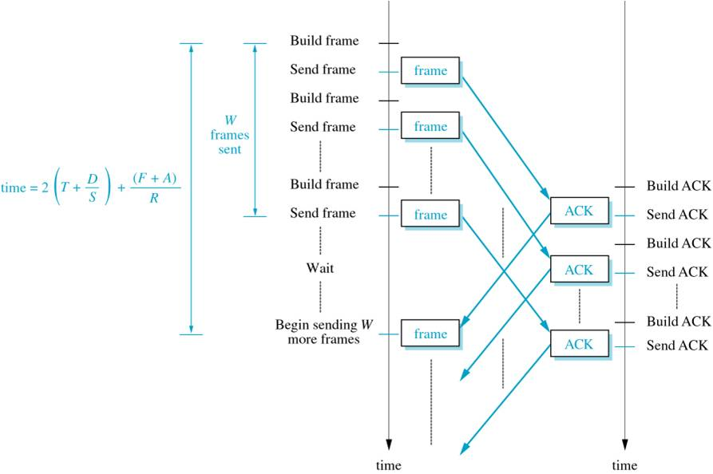
Efficiency of Sliding Window Protocols
Sending All Windowed Frames and Waiting – Case 2
Transport Layer A
3-‹#›

Slide 69
Efficiency of Sliding Window Protocols
what is the effective data rate then?
Case 1 is actually the unrestricted protocol, hence
➔ EDR = N/(T + F/R)
Case 2 is actually the W-Oriented stop-and-wait, hence
➔ EDR = (W * N)/[2(T + D/S) + (F + A)/R]
here W * N replaced N in the original calculation. Why?
Transport Layer A
3-‹#›

Slide 70
Efficiency of Sliding Window Protocols
Example: Assume:
R = 10 Mbps (10 bits /µsec)
S = 200 meters/µsec
D = 200 meters
T = 1 µsec
F = 200 bits
N = 160 bits
A = 40 bits
W = 4 frames
➔ applying these values, Case 1 condition is the one satisfied; so it is unrestricted version and the efficiency can be calculated as:
➔ EDR = N/( T + F/R) ≈ 7.6 Mbps
Transport Layer A
3-‹#›

Slide 71
Efficiency of Sliding Window Protocols
Example: Assume:
R = 10 Mbps (10 bits /µsec)
S = 200 meters/µsec
D = 5000 meters
T = 1 µsec
F = 200 bits
N = 160 bits
A = 40 bits
W = 4 frames
applying these values, Case 2 condition is the one satisfied; so
EDR = (W * N)/[2(T + D/S) + (F + F)/R]
= (4 * 160 bits)/[2(1 µsec + 5000 meters/ 200 meters/µsec) + 400 bits/ 10 bits /µsec]
= 640 bits /[2(26 µsec) + 40 µsec]
= 640 bits / 96 µsec
= 6.96 Mbps
notice that in that example all ACKs are piggybacked so F replaces A in the computation of EDR
Transport Layer A
3-‹#›

Slide 72
Protocol Correctness
does these protocols work? Will they fail in other cases that we do not know?
in order to guarantee that a protocol works, formal proof is needed
however, sometimes it is very difficult to derive formal proofs
a reasonable alternative in such cases is verification
two common verification tools are:
Finite State Machines (FSM)
Petri Net (similar to FSM in that it uses graphs to represent states and transitions, but does it in a different way)
Transport Layer A
3-‹#›

Slide 73
Protocol Correctness
Finite State Machine
indicates all possible states
trace the different events that changes one state to another (or possibly back to the same state)
an event that causes a change of state is called state transition
a State Transition Diagram (STD) can then be used to represent an algorithm
Transport Layer A
3-‹#›

Slide 74
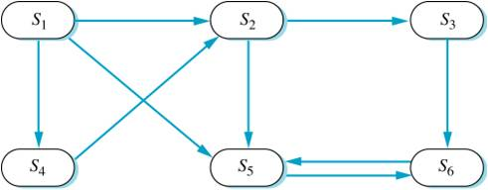
Protocol Correctness
Finite State Machine
what can you observe by looking at the following STD?
General State Transition Diagram
Transport Layer A
3-‹#›

Slide 75
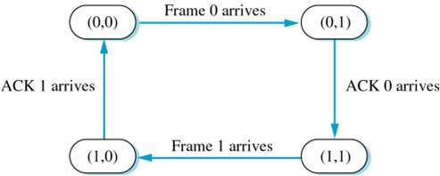
Protocol Correctness
Finite State Machine
STD for a simplified go-back-n protocol
assume: k=1, window size is 1, no time-out or retransmission and data go from sender to receiver
➔ this is like stop-and-wait protocol with frame numbers
(x,y) ≡ x is the ACK number and y is the next expected frame number for example, (0,1) means there is an ACK for frame 0 and the next expected frame is 1
Transport Layer A
3-‹#›
STD for a stop-and-wait Protocol with Frame Numbers

